Slide 1
DEEP LEARNING MODELS ON KERAS AND TENSORFLOW
Prof J. W. Muteba Mwamba

Slide 2
DEEP LEARNING TIMELINE -1/4
1957 - Perceptron:
The perceptron, developed by Frank Rosenblatt, is one of the earliest forms of neural networks.
It consists of a single layer of artificial neurons that can process input data and make simple decisions based on learned parameters.
1986 - Backpropagation:
The backpropagation algorithm, allows neural networks to efficiently learn and adjust their internal parameters, enabling the training of deeper networks.
It calculates the gradient of the loss function with respect to the network's weights, allowing for the optimization of deeper networks through iterative updates
Late 1980s - early 1990s: Convolutional Neural Networks (CNNs)
CNNs are specialized neural networks designed for processing grid-like data, such as images.
They use convolutional layers to automatically learn hierarchical patterns and features from input images, making them highly effective for tasks like image classification and object detection.

Slide 3
DEEP LEARNING TIMELINE -2/4
Late 1980s - early 1990s: Recurrent Neural Networks (RNNs):
RNNs are designed to process sequential data by maintaining an internal state or memory. They are capable of capturing temporal dependencies in data, making them suitable for tasks such as time series prediction, speech recognition, and natural language processing.
1997 - Long Short-Term Memory (LSTM) Networks:
LSTMs are a type of RNN that address the vanishing gradient problem and are capable of learning and remembering long-term dependencies in sequential data. They utilize specialized memory cells with gating mechanisms to control the flow of information, making them particularly effective for tasks involving long sequences.
2006: - Deep Belief Networks (DBNs):
DBNs are deep neural networks composed of multiple layers of restricted Boltzmann machines (RBMs). They utilize unsupervised learning to pre-train each layer before fine-tuning the entire network using supervised learning. DBNs are known for their ability to perform hierarchical feature learning.

Slide 4
DEEP LEARNING TIMELINE -3/4
2012 - ImageNet Competition:
The ImageNet competition marked a breakthrough in image classification accuracy with the introduction of AlexNet, a deep CNN architecture. AlexNet significantly outperformed previous methods by employing multiple convolutional layers and utilizing techniques such as ReLU activation functions and dropout regularization.
2013 - Deep Reinforcement Learning:
Deep reinforcement learning, combining deep neural networks with reinforcement learning algorithms to enable agents to learn from interactions with an environment.
It has been successfully applied to various tasks such as playing video games, robotics, and autonomous driving.
2014 - Generative Adversarial Networks (GANs):
GANs consist of two neural networks, a generator and a discriminator, trained simultaneously in a game-like setting. The generator aims to generate realistic data samples, while the discriminator learns to distinguish between real and fake samples. GANs have been used for tasks such as image generation, style transfer, and data augmentation.

Slide 5
DEEP LEARNING TIMELINE -4/4
2017 - Transformer Architecture:
The Transformer architecture, introduced in the paper "Attention is All You Need" by Vaswani et al., revolutionized NLP tasks by utilizing self-attention mechanisms, enabling parallel processing of input sequences.
Transformers are capable of processing input sequences in parallel, making them highly efficient for tasks such as machine translation, text summarization, and language modeling.
2018 - present - Large Language Models:
The development of large language models, such as OpenAI's GPT series and Google's BERT, marked a milestone in NLP. These models leverage vast amounts of text data and sophisticated architectures to achieve human-level performance on various language tasks.
Large language models excel at various natural language processing tasks, including text generation, translation, sentiment analysis, and question answering.

Slide 6
DEEP LEARNING TIMELINE
2018 – Present
2018 – Present: Large Language Models (LLMs) Expansion
• The era of transformer-based LLMs began, rapidly increasing in size and capability. • Key models: BERT (2018), GPT-2 (2019), T5 (2019), GPT-3 (2020), PaLM (2022), GPT-4 (2023), Gemini (2023), Llama 2 (2023). • Applications include text generation, code, translation, and more.

Slide 7
DEEP LEARNING TIMELINE
2020: Multimodal Deep Learning
Multimodal Models
• Models process/generate multiple data types (text, images, audio). • OpenAI's CLIP (2021) and DALL-E (2021) allowed image understanding/generation via language. • Google’s Gemini (2023) integrates vision, language, reasoning.

Slide 8
DEEP LEARNING TIMELINE
2021–2023: Efficient and Responsible AI
Model Efficiency & Democratization
• Efficient methods (LoRA, adapters, quantization) enable wider access. • Rise of open-source LLMs (Llama, MPT, Falcon). • Focus on reducing bias, improving transparency, and safe deployment (RLHF).

Slide 9
DEEP LEARNING TIMELINE
2023–2025: Agents, Tools, Reasoning
AI Agents & Tool Use
• LLMs became agents that use tools, APIs, and external knowledge. • RAG systems integrate external databases for up-to-date answers. • Progress in logical reasoning, planning, and autonomous tasks.

Slide 10
DEEP LEARNING TIMELINE
2024 – Present: Universal Foundation Models
Unified Multimodal & Foundation Models
• GPT-4o, Gemini Ultra process/generate text, images, audio, video. • Applications: education, healthcare, creative arts, research, more. • Personalization, on-device AI, privacy-preserving deployments.

Slide 11
APPLICATIONS OF LLMs IN FINANCIAL ENGINEERING
APPLICATIONS OF LLMs IN FINANCIAL ENGINEERING

Slide 12
I. Market Intelligence & Automated Risk Assessment
Problem 1: Real-Time Market Intelligence & News Impact Analysis
Research Question: How can we automatically analyze global news and social media to assess real-time market sentiment and forecast asset price movements? LLM Solution: LLMs like GPT-4 process vast news and social streams in real time, classify sentiment, extract entities, and summarize likely impacts of events on assets. Example: Investment banks use LLM-powered dashboards to flag news likely to trigger volatility, giving traders early actionable signals.
Problem 2: Automated Credit Risk Assessment
Research Question: How can we automate and improve borrower credit risk assessment using unstructured data? LLM Solution: LLMs analyze unstructured data (news, legal filings, alt-data) about borrowers to build holistic risk profiles and provide early warnings. Example: Fintech lenders assess SMEs or individuals with little credit history by analyzing public records and alternative sources with LLMs.

Slide 13
II. Quantitative Trading & Regulatory Compliance
Problem 3: Strategy Development for Quantitative Trading
Research Question: How can we generate, test, and explain new quantitative trading strategies using large-scale financial data? LLM Solution: LLMs help generate ideas, write code for strategies, and auto-create backtesting scripts; they also explain strategy logic for review. Example: Hedge funds use LLM copilots to accelerate the research and testing of new trading strategies, speeding time to market.
Problem 4: Automated Regulatory Compliance Monitoring
Research Question: How can we streamline compliance by detecting and interpreting changes in global financial regulations? LLM Solution: LLMs monitor regulatory news, extract rule changes, summarize impacts, and draft documentation for compliance teams. Example: Banks deploy LLMs to track global regulatory updates and alert compliance staff, reducing manual review burdens.

Slide 14
III. LLMs in Portfolio Optimization & Risk Management
Problem 5: Portfolio Optimization with Unstructured Data
Research Question: How can investors use alternative data (news, ESG, earnings calls) to rebalance portfolios? LLM Solution: LLMs analyze unstructured financial texts, extract market signals, and recommend asset allocation. Example: Asset managers use LLMs to incorporate sentiment and ESG trends into portfolio models, improving risk-adjusted returns.
Problem 6: Advanced Risk Management
Research Question: How can we proactively detect emerging risks across global portfolios? LLM Solution: LLMs synthesize risk signals from filings, social media, and reports, enabling early warnings and scenario analysis. Example: Banks use LLMs for automated risk reports and stress-testing across diverse portfolios.

Slide 15
IV. LLMs for Cryptocurrency, Options Pricing, Econometrics
Problem 7: Cryptocurrency Analytics and Market Surveillance
Research Question: How can LLMs support fraud detection and market analysis in crypto markets? LLM Solution: LLMs monitor on-chain data, whitepapers, and news to flag scams or manipulation. Example: Crypto exchanges use LLMs to automate compliance, detect suspicious transactions, and summarize regulatory changes.
Problem 8: Options Pricing & Econometric Forecasting
Research Question: How can LLMs improve pricing models for derivatives and macroeconomic forecasting? LLM Solution: LLMs review research, extract insights from statements, and support scenario-based pricing and forecasting. Example: Quant desks use LLMs to parse reports, predict macro variables, and calibrate options models.

Slide 16
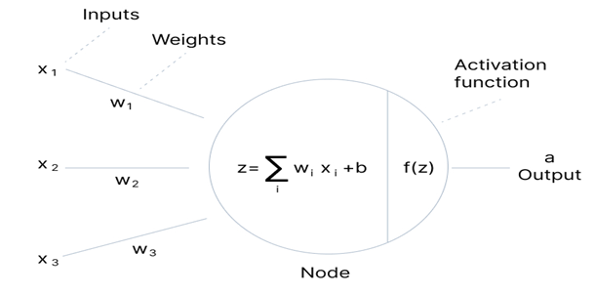
1. Perceptron with one Neuron
The building block of a Deep Learning model is a perceptron
Notes:
The original perceptron did not have an activation function, it used a step function to output either 1 or 0

Slide 17
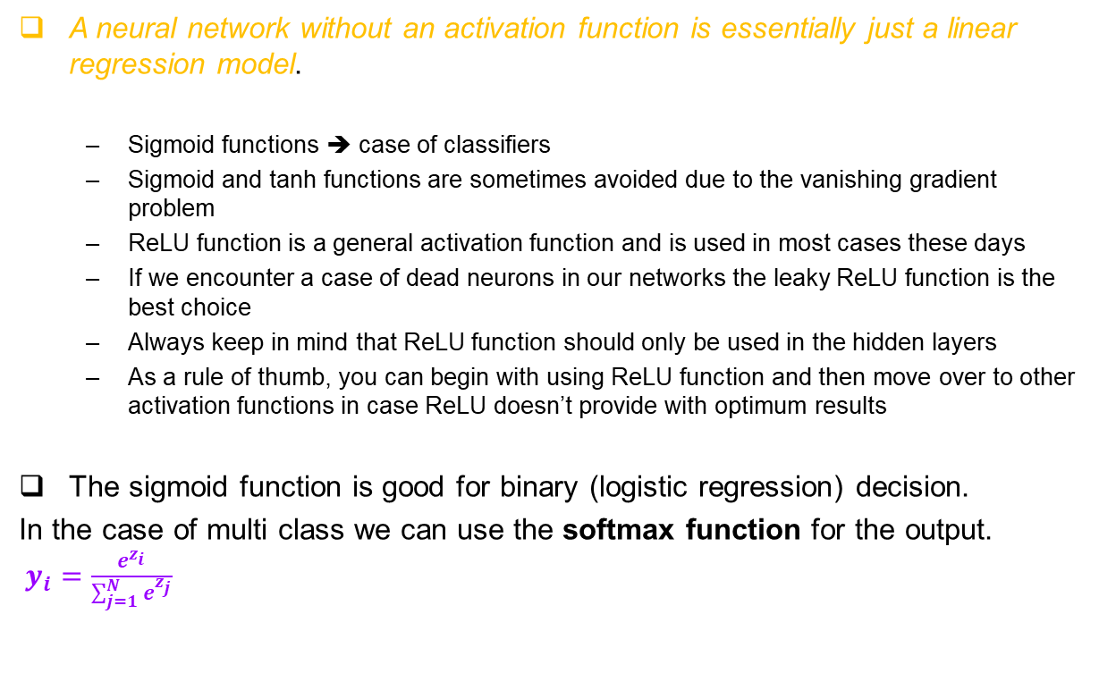
Proposed Activation function
A neural network without an activation function is essentially just a linear regression model.
Sigmoid functions ➔ case of classifiers
Sigmoid and tanh functions are sometimes avoided due to the vanishing gradient problem
ReLU function is a general activation function and is used in most cases these days
If we encounter a case of dead neurons in our networks the leaky ReLU function is the best choice
Always keep in mind that ReLU function should only be used in the hidden layers
As a rule of thumb, you can begin with using ReLU function and then move over to other activation functions in case ReLU doesn’t provide with optimum results
The sigmoid function is good for binary (logistic regression) decision.
In the case of multi class we can use the softmax function for the output. $y_{i}=\frac{e^{z_{i}}}{\sum_{j=1}^{N}{e^{z_{j}}}}$

Slide 18
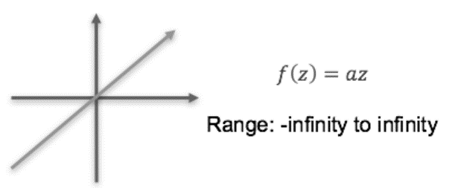
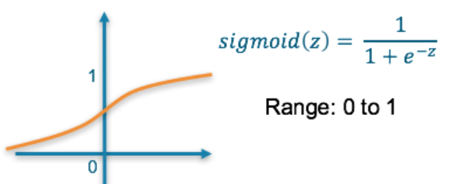
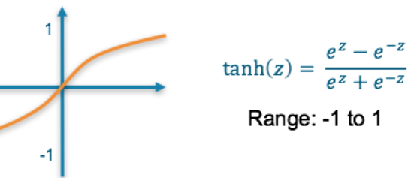
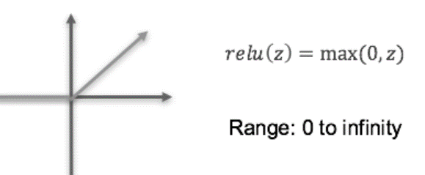
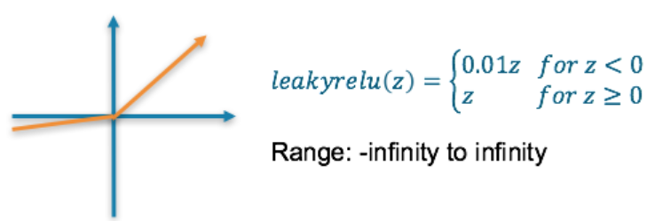
Proposed Activation functions:
Linear Activation Function Sigmoid, tanh Activation Function
Doesn’t capture complex patterns Bounded, capture more complex patterns ,
Can suffer from “vanishing gradient”
Rectified Linear Unit (ReLU) Leaky ReLU Activation Function
Capture more complex patterns, Values can get very large, not allow for negative values,

Slide 19
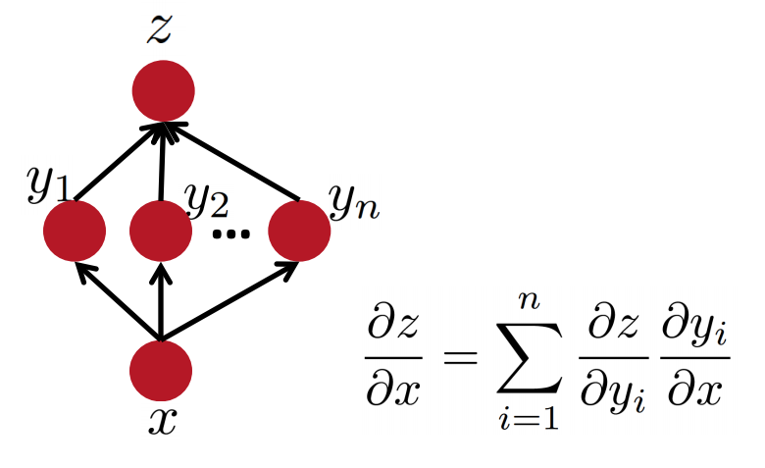
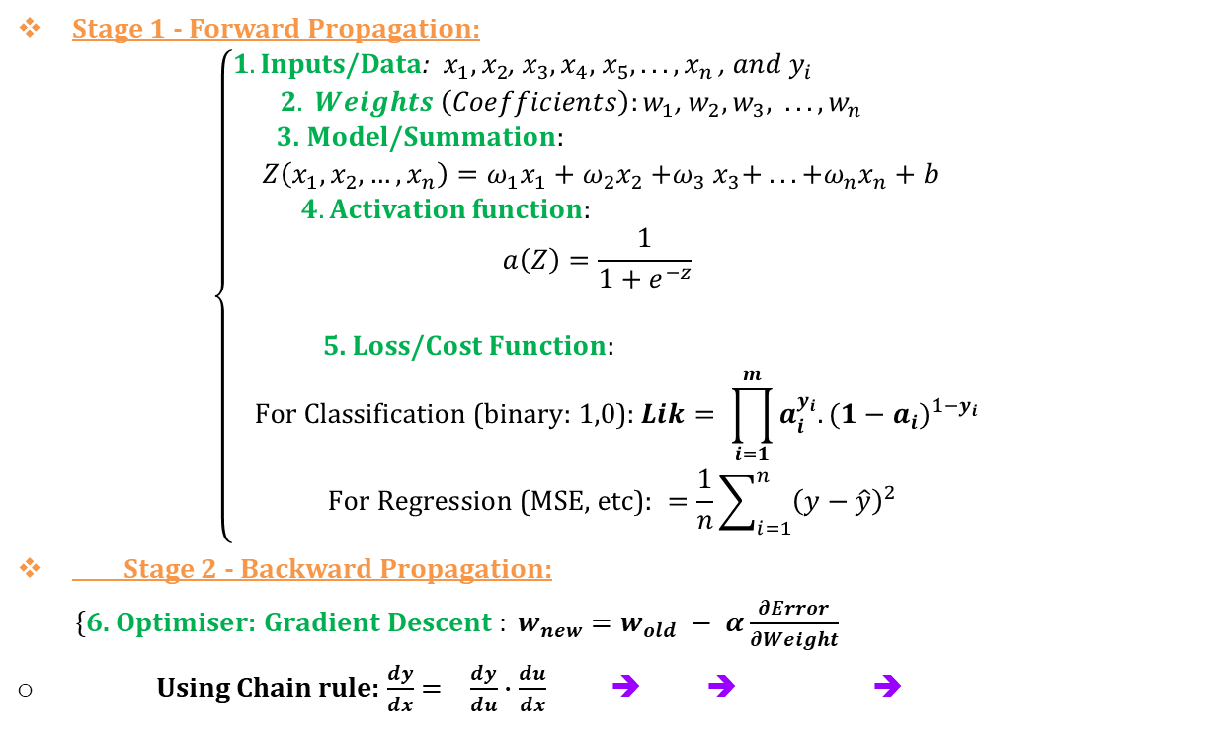
I. Setting Up Neural Network: Needed Elements
Stage 1 - Forward Propagation:
$$\left\{\begin{aligned}1. \text{Inputs}\text{/}\text{Data}\text{: }x_{1},x_{2}\text{, }x_{3},x_{4}\text{, }x_{5}, . . . , x_{n} \text{,} and y_{i} \\ 2. Weights \left(Coefficients\right):w_{1}\text{, }w_{2},w_{3}\text{, } . . . , w_{n} \\ \text{3. }\text{Model}\text{/}\text{Summation}\text{: } \\ Z\left(x_{1},x_{2}, …,x_{n}\right)=ω_{1}x_{1}+ω_{2}x_{2}{+ω}_{3}x_{3}+ . . . +ω_{n}x_{n}+b \\ 4. \text{Activation} \text{function}\text{:} \\ a\left(Z\right)=\frac{1}{1+e^{−z}} \\ \\ \text{5. }\text{Loss}\text{/}\text{Cost} \text{Function}\text{:} \\ \text{For} \text{Classification}\text{ (}\text{binary}\text{: 1,0): }Lik= \prod_{i=1}^{m}{a_{i}^{y_{i}}.(1−a_{i})^{1−y_{i}}} \\ \text{For} \text{Regression}\text{ (}\text{MSE}\text{, }\text{etc}\text{): }{=\frac{1}{n}\sum_{i=1}^{n}{{\left(y−\hat{y}\right)}^{2}}}_{}\end{aligned}\right.$$
Stage 2 - Backward Propagation:
$\left\{\text{6. }\text{Optimiser}\text{: }\text{Gradient} \text{Descent} \right.: w_{new}=w_{old} − α\frac{∂Error}{∂Weight}$
Using Chain rule: $\frac{dy}{dx}= \frac{dy}{du}∙\frac{du}{dx}$ ➔ ➔ ➔

Slide 20
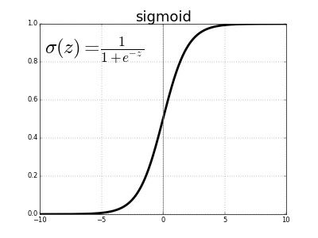

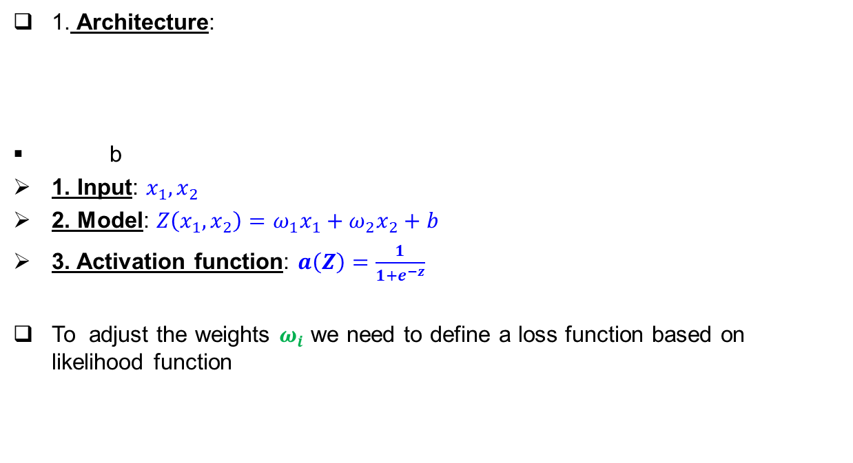


Example with 2 inputs
1. Architecture:
b
1. Input: $x_{1},x_{2}$
2. Model: $Z\left(x_{1},x_{2}\right)=ω_{1}x_{1}+ω_{2}x_{2}+b$
3. Activation function: $a\left(Z\right)=\frac{1}{1+e^{−z}}$
To adjust the weights $ω_{i}$ we need to define a loss function based on likelihood function
$$x_{1}$$
Z$/a$
$$x_{2}$$

Slide 21
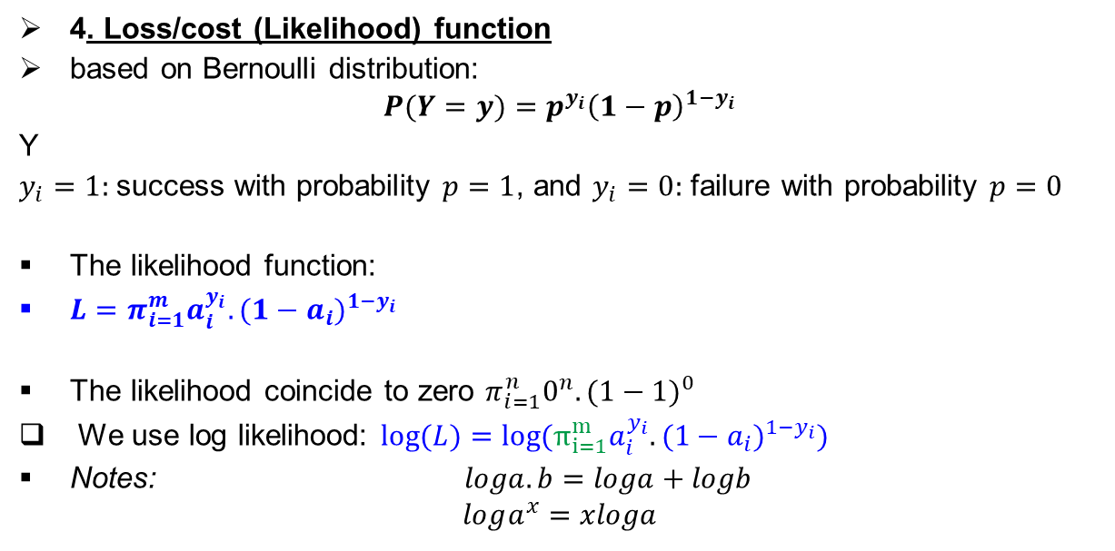
Example with 2 inputs
4. Loss/cost (Likelihood) function
based on Bernoulli distribution:
$$P(Y=y)=p^{y_{i}}{\left(1−p\right)}^{1−y_{i}}$$
Y
$y_{i}=1:$success with probability $p=1$, and $y_{i}=0:$ failure with probability $p=0$
The likelihood function:
$L=π_{i=1}^{m}a_{i}^{y_{i}}.(1−a_{i})^{1−y_{i}}$
The likelihood coincide to zero $π_{i=1}^{n}0^{n}.(1−1)^{0}$
We use log likelihood: $log⁡(L)=log⁡(π_{i=1}^{m}a_{i}^{y_{i}}.(1−a_{i})^{1−y_{i}})$
Notes: $loga.b=loga+logb$
$$loga^{x}=xloga$$

Slide 22
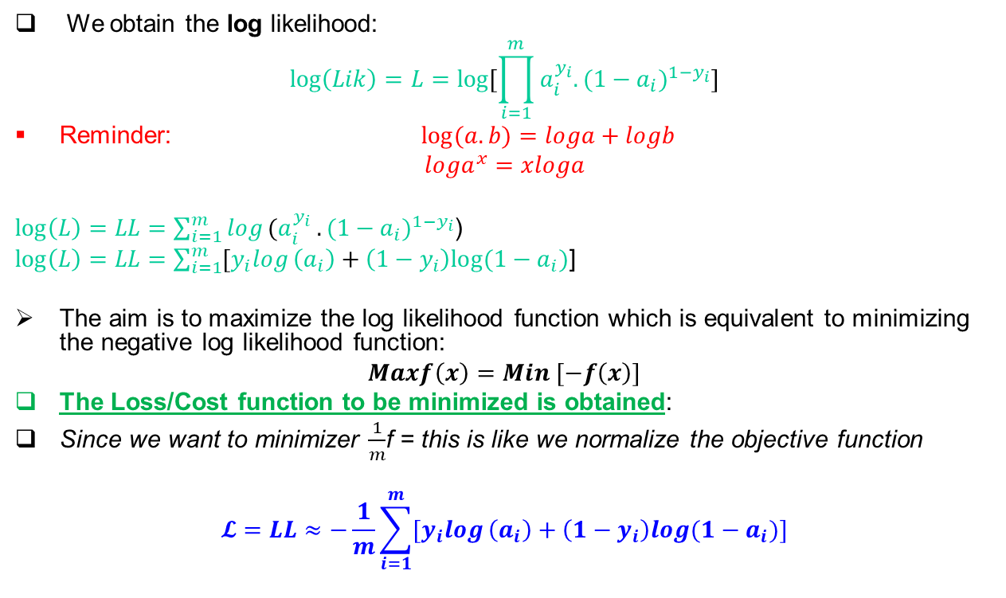
Example with 2 inputs:
We obtain the log likelihood:
$$\log\left(Lik\right)=L=log⁡[\prod_{i=1}^{m}{a_{i}^{y_{i}}.(1−a_{i})^{1−y_{i}}]}$$
Reminder: $log⁡(a.b)=loga+logb$
$$loga^{x}=xloga$$
$\log\left(L\right)=LL=\sum_{i=1}^{m}{log}(a_{i}^{y_{i}} .(1−a_{i})^{1−y_{i}}$)
$\log\left(L\right)=LL=\sum_{i=1}^{m}{{[y}_{i}log}\left(a_{i}\right)+\left(1−y_{i}\right)log⁡(1−a_{i})$]
The aim is to maximize the log likelihood function which is equivalent to minimizing the negative log likelihood function:
$$Maxf\left(x\right)=Min [−f\left(x\right)]$$
The Loss/Cost function to be minimized is obtained:
Since we want to minimizer $\frac{1}{m}$f = this is like we normalize the objective function
$$𝓛=LL≈−\frac{1}{m}\sum_{i=1}^{m}{{[y}_{i}log}\left(a_{i}\right)+\left(1−y_{i}\right)log⁡(1−a_{i})]$$

Slide 23
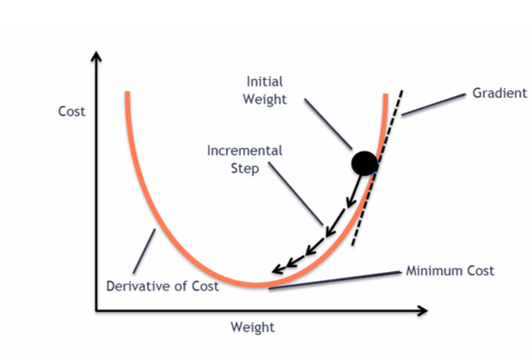
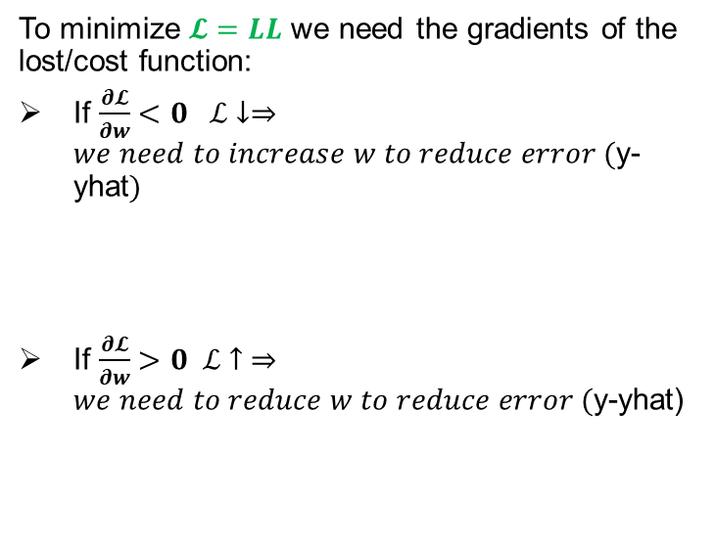
Example with 2 inputs: GRADIENT DESCENT optimiser
Gradient Descent -1/5
To minimize $𝓛=LL$ we need the gradients of the lost/cost function:
If $\frac{∂𝓛}{∂w}<0 ℒ↓⇒we need to increase w to reduce error ($y-yhat$)$
If $\frac{∂𝓛}{∂w}>0 ℒ↑ ⇒we need to reduce w to reduce error ($y-yhat)

Slide 24
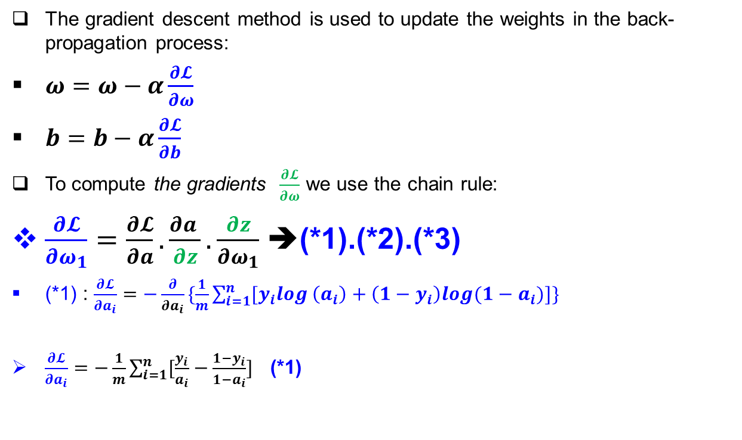
Example with 2 inputs - Gradient Descent -2/5
The gradient descent method is used to update the weights in the back-propagation process:
$ω=ω−α\frac{∂𝓛}{∂ω}$
$b=b−α\frac{∂𝓛}{∂b}$
To compute the gradients $\frac{∂𝓛}{∂ω}$ we use the chain rule:
$\frac{∂𝓛}{∂ω_{1}}=\frac{∂𝓛}{∂a}.\frac{∂a }{∂z}.\frac{∂z}{∂ω_{1}}$ ➔(*1).(*2).(*3)
(*1) : $\frac{∂𝓛}{∂a_{i}}=−\frac{∂}{∂a_{i}}\{\frac{1}{m}\sum_{i=1}^{n}{{[y}_{i}log}\left(a_{i}\right)+\left(1−y_{i}\right)log⁡(1−a_{i})]\}$
$\frac{∂𝓛}{∂a_{i}}=−\frac{1}{m}\sum_{i=1}^{n}{[\frac{y_{i}}{a_{i}}−\frac{1−y_{i}}{1−a_{i}}]}$ (*1)

Slide 25
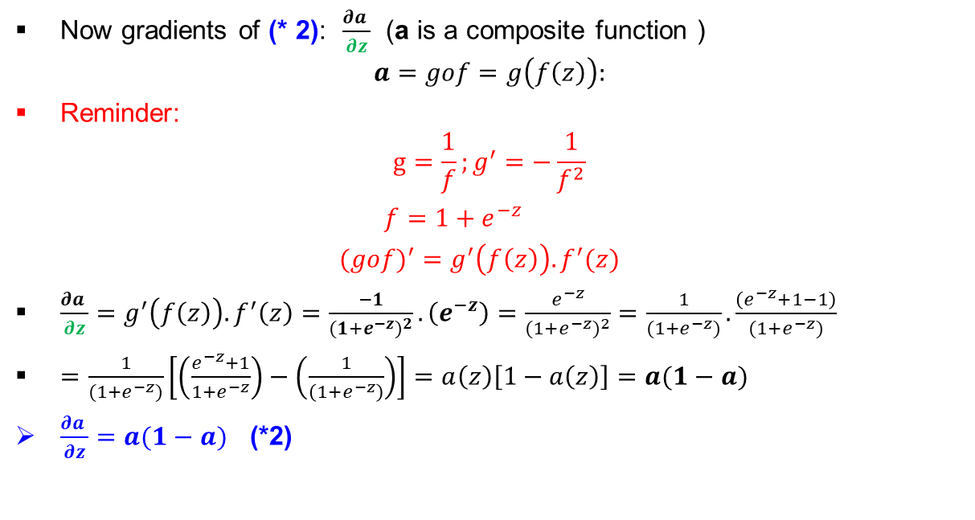
Example with 2 inputs - Gradient Descent Method -3/5
Now gradients of (* 2): $\frac{∂a }{∂z}$ (a is a composite function )
$$a=gof=g\left(f\left(z\right)\right):$$
Reminder:
$$g=\frac{1}{f};g^{′}=−\frac{1}{f^{2}}$$
$f=1+e^{−z}$
$(gof)^{′}=g^{′}\left(f\left(z\right)\right).f^{′}(z)$
$\frac{∂a }{∂z}=g^{′}\left(f\left(z\right)\right).f^{′}\left(z\right)=\frac{−1}{(1+e^{−z})^{2}}.\left(e^{−z}\right)=\frac{e^{−z}}{(1+e^{−z})^{2}}=\frac{1}{(1+e^{−z})}.\frac{\left(e^{−z}+1−1\right)}{(1+e^{−z})}$
$=\frac{1}{(1+e^{−z})}\left[\left(\frac{e^{−z}+1}{1+e^{−z}}\right)−\left(\frac{1}{\left(1+e^{−z}\right)}\right)\right]=a\left(z\right)\left[1−a\left(z\right)\right]=a(1−a)$
$\frac{∂a }{∂z}=a(1−a)$ (*2)

Slide 26
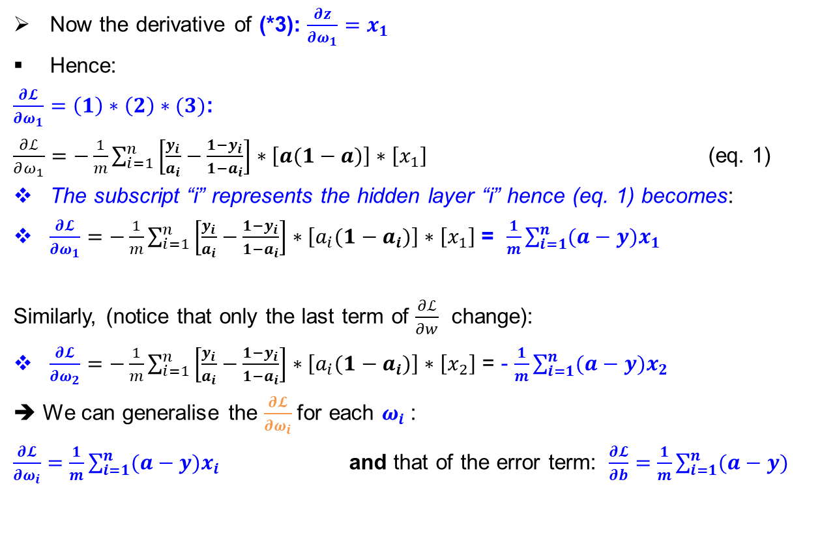
Example with 2 inputs - Gradient Descent Method -4/5
Now the derivative of (*3): $\frac{∂z}{∂ω_{1}}=x_{1}$
Hence:
$\frac{∂𝓛}{∂ω_{1}}=\left(1\right)∗\left(2\right)∗(3)$:
$\frac{∂ℒ}{∂ω_{1}}=−\frac{1}{m}\sum_{i=1}^{n}{\left[\frac{y_{i}}{a_{i}}−\frac{1−y_{i}}{1−a_{i}}\right]}∗\left[a(1−a)\right]∗\left[x_{1}\right]$ (eq. 1)
The subscript “i” represents the hidden layer “i” hence (eq. 1) becomes:
$\frac{∂𝓛}{∂ω_{1}}=−\frac{1}{m}\sum_{i=1}^{n}{\left[\frac{y_{i}}{a_{i}}−\frac{1−y_{i}}{1−a_{i}}\right]}∗\left[a_{i}(1−a_{i})\right]∗\left[x_{1}\right]$ = $\frac{1}{m}\sum_{i=1}^{n}{(a−y)x_{1}}$
Similarly, (notice that only the last term of $\frac{∂ℒ}{∂w}$ change):
$\frac{∂𝓛}{∂ω_{2}}=−\frac{1}{m}\sum_{i=1}^{n}{\left[\frac{y_{i}}{a_{i}}−\frac{1−y_{i}}{1−a_{i}}\right]}∗\left[a_{i}(1−a_{i})\right]∗\left[x_{2}\right]$ = - $\frac{1}{m}\sum_{i=1}^{n}{(a−y)x_{2}}$
➔ We can generalise the $\frac{∂𝓛}{∂ω_{i}}$for each $ω_{i}$:
$\frac{∂𝓛}{∂ω_{i}}=\frac{1}{m}\sum_{i=1}^{n}{(a−y)x_{i}}$ and that of the error term: $\frac{∂𝓛}{∂b}=\frac{1}{m}\sum_{i=1}^{n}{(a−y) }$
Notes:
Keeping the subscript “i” on a away, we obtain the partial derivatives of each wi

Slide 27
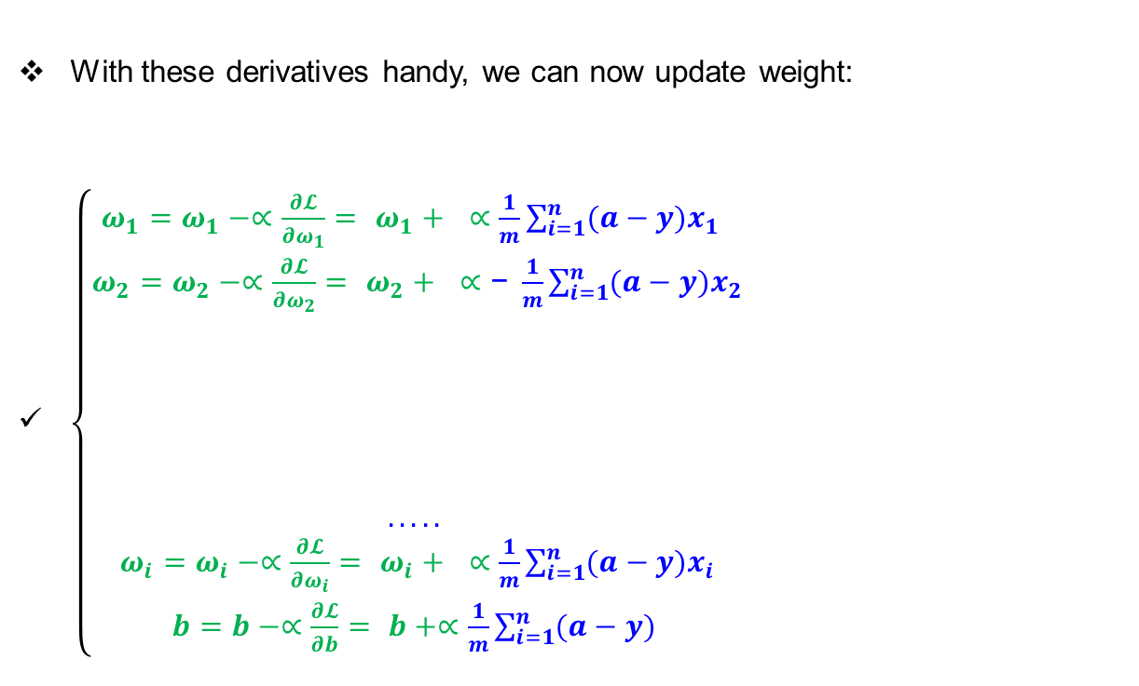
Example with 2 inputs - Gradient Descent Method -5/5
With these derivatives handy, we can now update weight:
$\left\{\begin{aligned}ω_{1}=ω_{1}−∝\frac{∂𝓛}{∂ω_{1}}= ω_{1}+ ∝\frac{1}{m}\sum_{i=1}^{n}{(a−y)x_{1}} \\ ω_{2}=ω_{2}−∝\frac{∂𝓛}{∂ω_{2}}= ω_{2}+ ∝\text{− }\frac{1}{m}\sum_{i=1}^{n}{(a−y)x_{2}} \\ \\ \\ \\ \\ \\ . . . . . \\ ω_{i}=ω_{i}−∝\frac{∂𝓛}{∂ω_{i}}= ω_{i}+ ∝\frac{1}{m}\sum_{i=1}^{n}{(a−y)x_{i}} \\ b=b−∝\frac{∂𝓛}{∂b}= b+∝\frac{1}{m}\sum_{i=1}^{n}{(a−y) }\end{aligned}\right.$

Slide 28
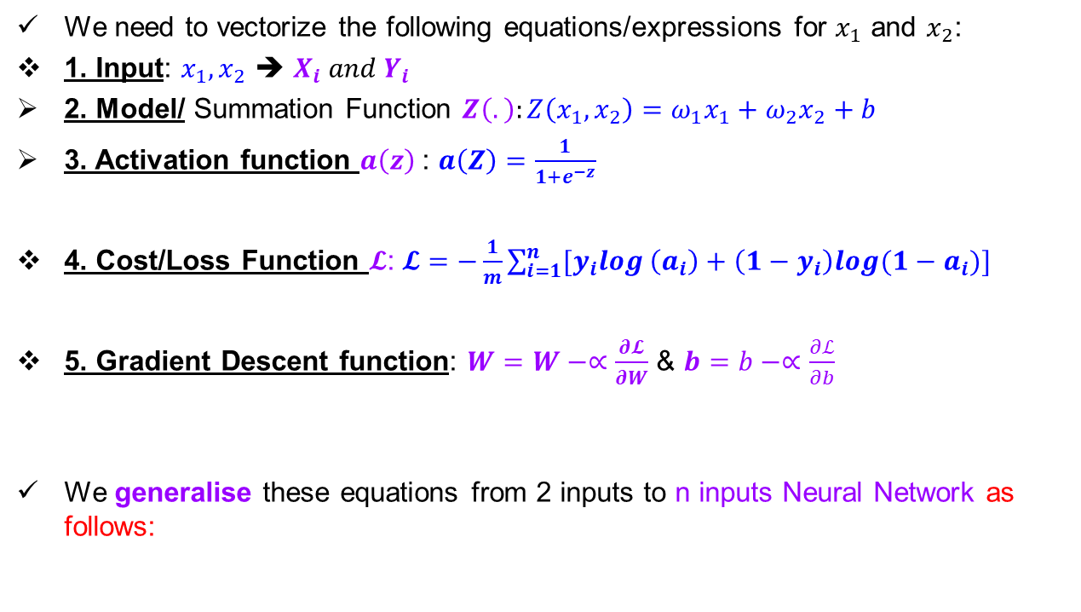
II. Vectorization of Equations for 2 inputs
We need to vectorize the following equations/expressions for $x_{1}$ and $x_{2}$:
1. Input: $x_{1},x_{2}$ ➔ $X_{i} and Y_{i}$
2. Model/ Summation Function $Z\left(.\right):Z\left(x_{1},x_{2}\right)=ω_{1}x_{1}+ω_{2}x_{2}+b$
3. Activation function $a\left(z\right)$: $a\left(Z\right)=\frac{1}{1+e^{−z}}$
4. Cost/Loss Function $𝓛$: $𝓛=−\frac{1}{m}\sum_{i=1}^{n}{{[y}_{i}log}\left(a_{i}\right)+\left(1−y_{i}\right)log⁡(1−a_{i})]$
5. Gradient Descent function: $W=W−∝\frac{∂𝓛}{∂W}$ & $b=b−∝\frac{∂ℒ}{∂b}$
We generalise these equations from 2 inputs to n inputs Neural Network as follows:

Slide 29
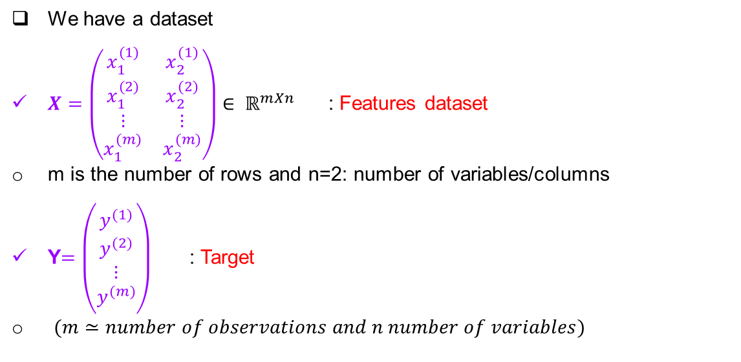
II.1. Vectorized dataset for 2 inputs
We have a dataset
$X=\left(\begin{matrix}x_{1}^{(1)} & x_{2}^{(1)} \\ \begin{matrix}\begin{matrix}x_{1}^{(2)} \\ ⋮\end{matrix} \\ x_{1}^{(m)}\end{matrix} & \begin{matrix}\begin{matrix}x_{2}^{(2)} \\ ⋮\end{matrix} \\ x_{2}^{(m)}\end{matrix}\end{matrix}\right)∈ ℝ^{mXn}$ : Features dataset
m is the number of rows and n=2: number of variables/columns
Y$=\left(\begin{matrix}y^{(1)} \\ \begin{matrix}y^{(2)} \\ ⋮\end{matrix} \\ y^{(m)}\end{matrix}\right)$ : Target
$(m≃number of observations and n number of variables)$

Slide 30
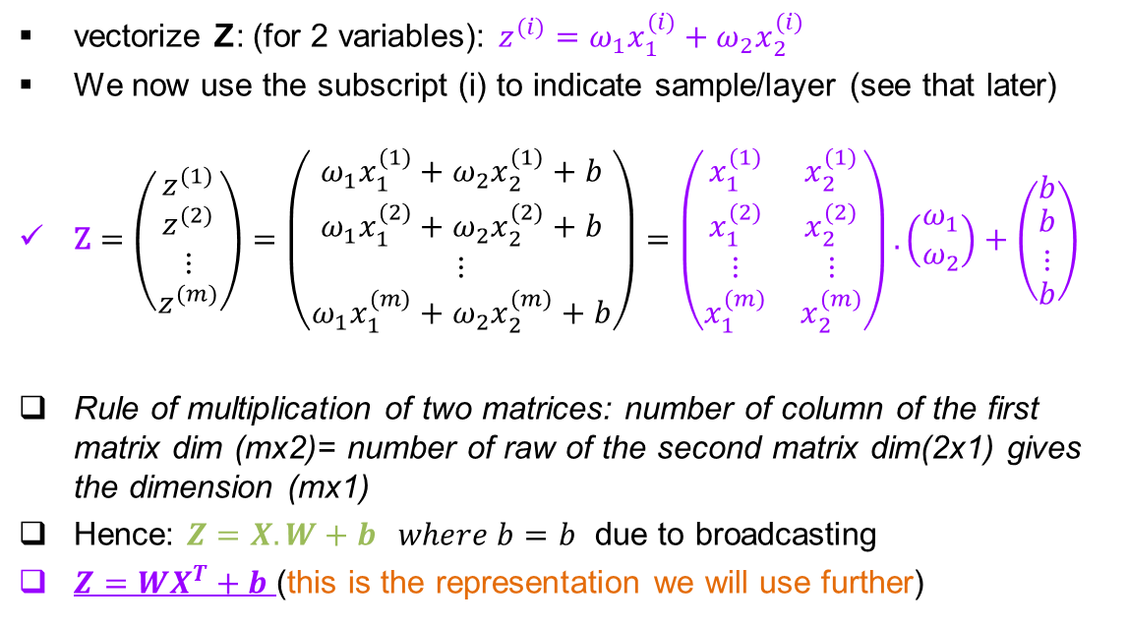
II.2. Vectorization of the Model/summation (Z) for 2 inputs
vectorize Z: (for 2 variables): $z^{(i)}=ω_{1}x_{1}^{(i)}+ω_{2}x_{2}^{(i)}$
We now use the subscript (i) to indicate sample/layer (see that later)
$\text{Z}=\left(\begin{matrix}z^{(1)} \\ \begin{matrix}z^{(2)} \\ ⋮\end{matrix} \\ z^{(m)}\end{matrix}\right)=\left(\begin{matrix}ω_{1}x_{1}^{(1)}+ω_{2}x_{2}^{(1)}+b \\ \begin{matrix}ω_{1}x_{1}^{(2)}+ω_{2}x_{2}^{(2)}+b \\ ⋮\end{matrix} \\ ω_{1}x_{1}^{(m)}+ω_{2}x_{2}^{(m)}+b\end{matrix}\right)=\left(\begin{matrix}x_{1}^{(1)} & x_{2}^{(1)} \\ \begin{matrix}\begin{matrix}x_{1}^{(2)} \\ ⋮\end{matrix} \\ x_{1}^{(m)}\end{matrix} & \begin{matrix}\begin{matrix}x_{2}^{(2)} \\ ⋮\end{matrix} \\ x_{2}^{(m)}\end{matrix}\end{matrix}\right).\left(\begin{matrix}ω_{1} \\ ω_{2}\end{matrix}\right)+\left(\begin{matrix}b \\ \begin{matrix}b \\ ⋮\end{matrix} \\ b\end{matrix}\right)$
Rule of multiplication of two matrices: number of column of the first matrix dim (mx2)= number of raw of the second matrix dim(2x1) gives the dimension (mx1)
Hence: $Z=X.W+b where b=b$ due to broadcasting
$Z=WX^{T}+b$ (this is the representation we will use further)

Slide 31
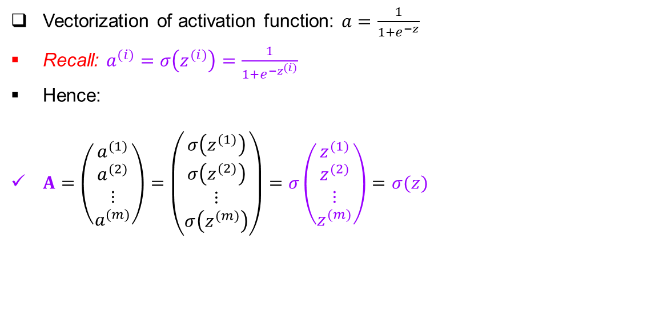
II.3. Vectorization of Activation Function for 2 inputs
Vectorization of activation function: $a=\frac{1}{1+e^{−z}}$
Recall: $a^{(i)}=σ\left(z^{(i)}\right)=\frac{1}{1+e^{−z^{(i)}}}$
Hence:
$A=\left(\begin{matrix}a^{(1)} \\ \begin{matrix}a^{(2)} \\ ⋮\end{matrix} \\ a^{(m)}\end{matrix}\right)=\left(\begin{matrix}σ\left(z^{(1)}\right) \\ \begin{matrix}σ\left(z^{(2)}\right) \\ ⋮\end{matrix} \\ σ\left(z^{(m)}\right)\end{matrix}\right)=σ\left(\begin{matrix}z^{(1)} \\ \begin{matrix}z^{(2)} \\ ⋮\end{matrix} \\ z^{(m)}\end{matrix}\right)=σ(z)$

Slide 32
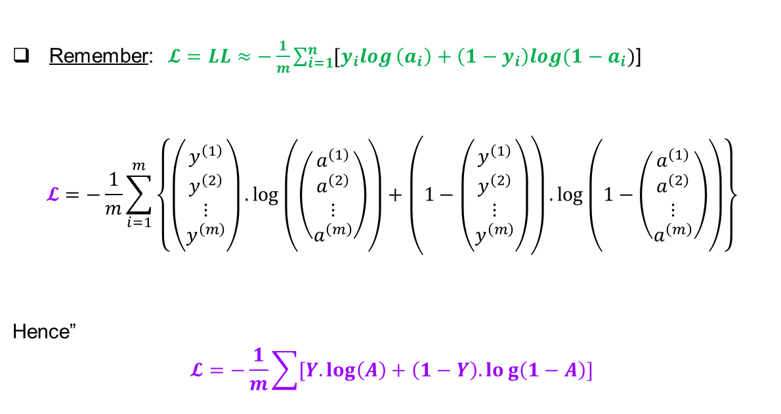
II.4. Vectorization of Loss/Cost Function for 2 inputs
Remember: $𝓛=LL≈−\frac{1}{m}\sum_{i=1}^{n}{{[y}_{i}log}\left(a_{i}\right)+\left(1−y_{i}\right)log⁡(1−a_{i})$]
$$𝓛=−\frac{1}{m}\sum_{i=1}^{m}{\left\{\left(\begin{matrix}y^{\left(1\right)} \\ \begin{matrix}y^{\left(2\right)} \\ ⋮\end{matrix} \\ y^{\left(m\right)}\end{matrix}\right).\log\left(\left(\begin{matrix}a^{\left(1\right)} \\ \begin{matrix}a^{\left(2\right)} \\ ⋮\end{matrix} \\ a^{\left(m\right)}\end{matrix}\right)\right)+\left(1−\left(\begin{matrix}y^{\left(1\right)} \\ \begin{matrix}y^{\left(2\right)} \\ ⋮\end{matrix} \\ y^{\left(m\right)}\end{matrix}\right)\right).\log\left(1−\left(\begin{matrix}a^{\left(1\right)} \\ \begin{matrix}a^{\left(2\right)} \\ ⋮\end{matrix} \\ a^{\left(m\right)}\end{matrix}\right)\right)\right\}}$$
Hence”
$$𝓛=−\frac{1}{m}\sum{[Y.\log\left(A\right)+\left(1−Y\right).log\left(1−A\right)]}$$

Slide 33
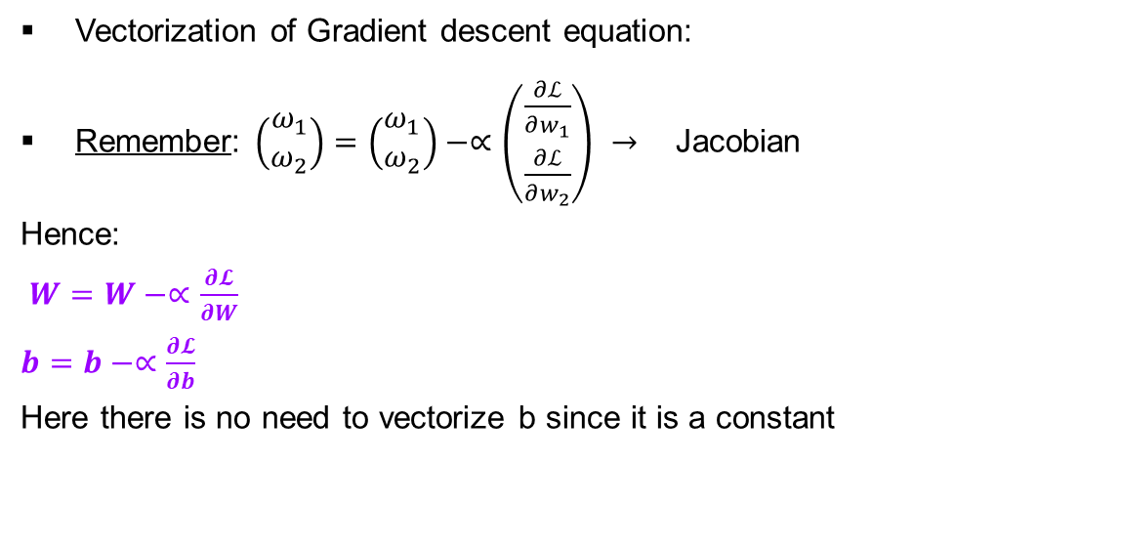
II.5. Vectorization of Gradient Descent Equations 2 inputs
Vectorization of Gradient descent equation:
Remember: $\left(\begin{matrix}ω_{1} \\ ω_{2}\end{matrix}\right)=\left(\begin{matrix}ω_{1} \\ ω_{2}\end{matrix}\right)−∝\left(\begin{matrix}\frac{∂ℒ}{∂w_{1}} \\ \frac{∂ℒ}{∂w_{2}}\end{matrix}\right)$ $→$ Jacobian
Hence:
$W=W−∝\frac{∂𝓛}{∂W}$
$b=b−∝\frac{∂𝓛}{∂b}$
Here there is no need to vectorize b since it is a constant

Slide 34
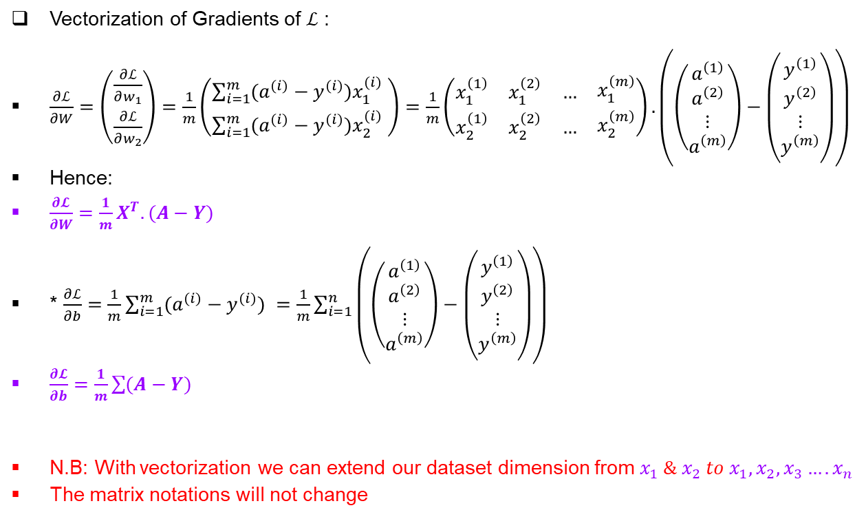
II.6. Vectorization of Derivatives of the Cost Function for 2 inputs with respect to W
Vectorization of Gradients of $ℒ$ :
$\frac{∂ℒ}{∂W}=\left(\begin{matrix}\frac{∂ℒ}{∂w_{1}} \\ \frac{∂ℒ}{∂w_{2}}\end{matrix}\right)=\frac{1}{m}\left(\begin{matrix}\sum_{i=1}^{m}{(a^{(i)}−y^{(i)})x_{1}^{(i)} } \\ \sum_{i=1}^{m}{(a^{(i)}−y^{(i)})x_{2}^{(i)} }\end{matrix}\right)=\frac{1}{m}\left(\begin{matrix}\begin{matrix}x_{1}^{\left(1\right)} & x_{1}^{\left(2\right)} & …\end{matrix} & x_{1}^{\left(m\right)} \\ \begin{matrix}x_{2}^{\left(1\right)} & x_{2}^{\left(2\right)} & …\end{matrix} & x_{2}^{\left(m\right)}\end{matrix}\right).\left(\left(\begin{matrix}a^{\left(1\right)} \\ \begin{matrix}a^{\left(2\right)} \\ ⋮\end{matrix} \\ a^{\left(m\right)}\end{matrix}\right)−\left(\begin{matrix}y^{\left(1\right)} \\ \begin{matrix}y^{\left(2\right)} \\ ⋮\end{matrix} \\ y^{\left(m\right)}\end{matrix}\right)\right)$
Hence:
$\frac{∂𝓛}{∂W}=\frac{1}{m}X^{T}.(A−Y)$
* $\frac{∂ℒ}{∂b}=\frac{1}{m}\sum_{i=1}^{m}{(a^{(i)}−y^{(i)}) }=\frac{1}{m}\sum_{i=1}^{n}{\left(\left(\begin{matrix}a^{\left(1\right)} \\ \begin{matrix}a^{\left(2\right)} \\ ⋮\end{matrix} \\ a^{\left(m\right)}\end{matrix}\right)−\left(\begin{matrix}y^{\left(1\right)} \\ \begin{matrix}y^{\left(2\right)} \\ ⋮\end{matrix} \\ y^{\left(m\right)}\end{matrix}\right)\right)}$
$\frac{∂𝓛}{∂b}=\frac{1}{m}\sum{(A−Y)}$
N.B: With vectorization we can extend our dataset dimension from $x_{1} \& x_{2} to x_{1},x_{2},x_{3}….x_{n}$
The matrix notations will not change

Slide 35
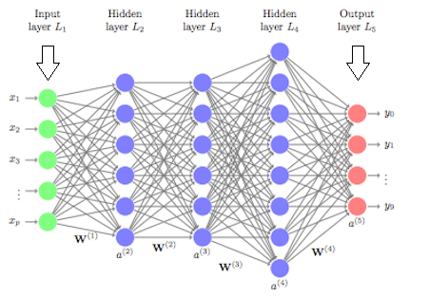
III. Training a Deep Learning: Model Architecture and Weights Matrices
Deep learning models are trained using a neural network architecture or a set of labeled data that contains multiple layers.
These architectures learn features directly from the data without hindrance to manual feature extraction.
Notes:
Hidden layers, weight matrices

Slide 36
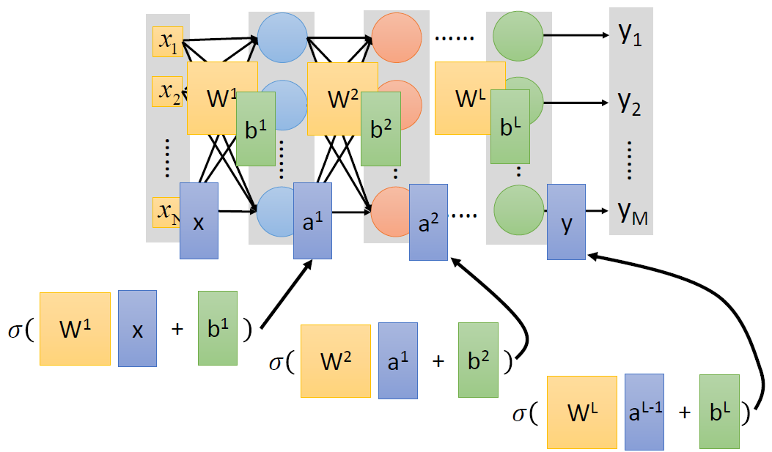
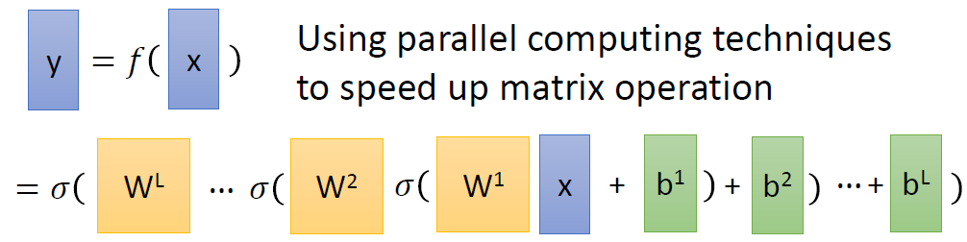
Feed Forward Neural Network Model
During forward propagation, the input is fed into the neural network, and the network calculates the output.

Slide 37
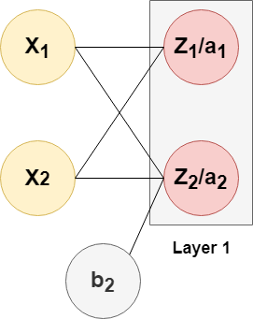

III. TRAINING A DL - FORWARD PROPAGATION for 2 input Model
$\begin{matrix}x_{1} \\ x_{2}\end{matrix}>0$ Is a perceptron $≡$ linear model
We add more neurons & hidden layers:
➔ calculate the weights, loss function, and Z values

Slide 38
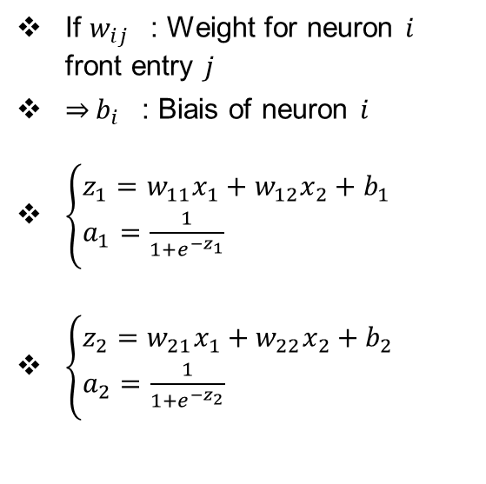
III. TRAINING A DL – Forward Propagation - Layer after Layer
.
If $w_{ij }$: Weight for neuron $i$ front entry $j$
$\overset{⇒}{}b_{i }$ : Biais of neuron $i$
$\left\{\begin{aligned}&z_{1}=w_{11}x_{1}+w_{12}x_{2}+b_{1} \\ &a_{1}=\frac{1}{1+e^{−z_{1}}}\end{aligned}\right.$
$\left\{\begin{aligned}&z_{2}=w_{21}x_{1}+w_{22}x_{2}+b_{2} \\ &a_{2}=\frac{1}{1+e^{−z_{2}}}\end{aligned}\right.$

Slide 39
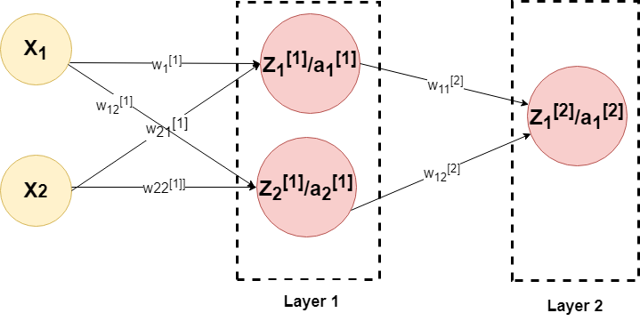

.
We can add more Neurons to this layer by using a subscript indicating the layer $\left[c\right]$
Where:
$w_{11}^{[2]}$ : Weight for $Z_{1}^{[2]}$ coming from $a_{1}^{[1]}$
$w_{12}^{[2]}$ : Weight for $Z_{1}^{[2]}$ coming from $a_{2}^{[1]}$
$\left\{\begin{aligned}&Z_{1}^{[2]}=w_{11}^{[2]}a_{1}^{[1]}+w_{12}^{[2]}a_{2}^{[1]}+b_{1}^{[2]} \\ &a_{1}^{[2]}=\frac{1}{1+e^{−{Z_{1}}^{[2]}}}\end{aligned}\right.$
Notes:
Layer 3

Slide 40
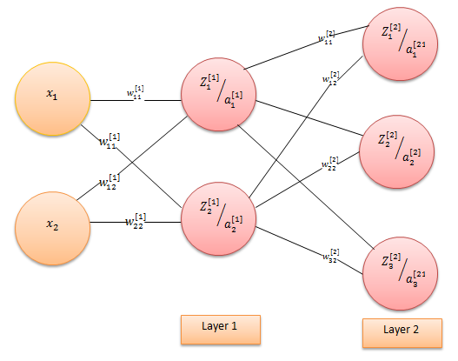

III. TRAINING A DL – Forward Propagation - Layer after Layer
We can add more neutrons in this Layer 2
$\left\{\begin{aligned}&{1st Neuron: z}_{1}^{\left[2\right]}=w_{11}^{\left[2\right]}a_{1}^{\left[1\right]}+w_{12}^{\left[2\right]}a_{2}^{\left[1\right]}+b_{1}^{\left[2\right]} \\ a_{1}^{\left[2\right]}=\frac{1}{1+e^{−z_{1}^{\left[2\right]}}} \\ …………….. \\ . \\ . \\ . \\ 2nd Neuron: z_{2}^{\left[2\right]}=w_{21}^{\left[2\right]}a_{1}^{\left[1\right]}+w_{22}^{\left[2\right]}a_{2}^{\left[1\right]}+b_{2}^{\left[2\right]} \\ & \\ a_{2}^{[2]}=\frac{1}{1+e^{−z_{2}^{[2]}}} \\ & \\ &{3rd Neuron: z}_{3}^{\left[2\right]}=w_{31}^{[2]}a_{1}^{[1]}+w_{32}^{[2]}a_{2}^{[2]}+b_{3}^{[2]} \\ &{ a}_{3}^{[2]}=\frac{1}{1+e^{−z_{3}^{[2]}}}\end{aligned}\right.$

Slide 41
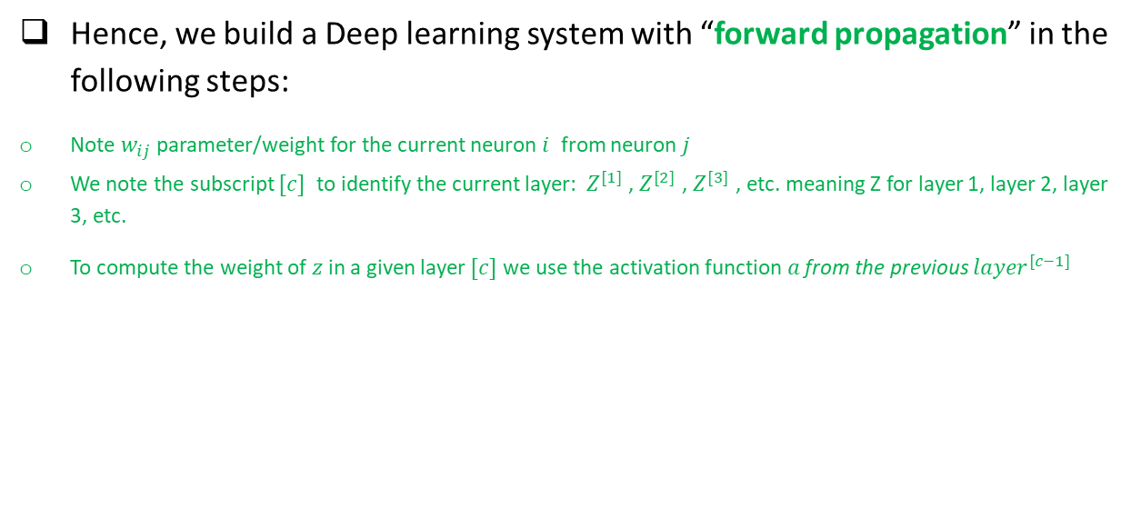
III. TRAINING A DL – Forward Propagation - The More layers and Neurons we add, the Deeper the Network
Hence, we build a Deep learning system with “forward propagation” in the following steps:
Note $w_{ij}$ parameter/weight for the current neuron $i$ from neuron $j$
We note the subscript $[c]$ to identify the current layer: $Z^{[1]}$ , $Z^{[2]}$ , $Z^{[3]}$ , etc. meaning Z for layer 1, layer 2, layer 3, etc.
To compute the weight of $z$ in a given layer $[c]$ we use the activation function $a$ from the previous ${layer}^{[c−1]}$

Slide 42
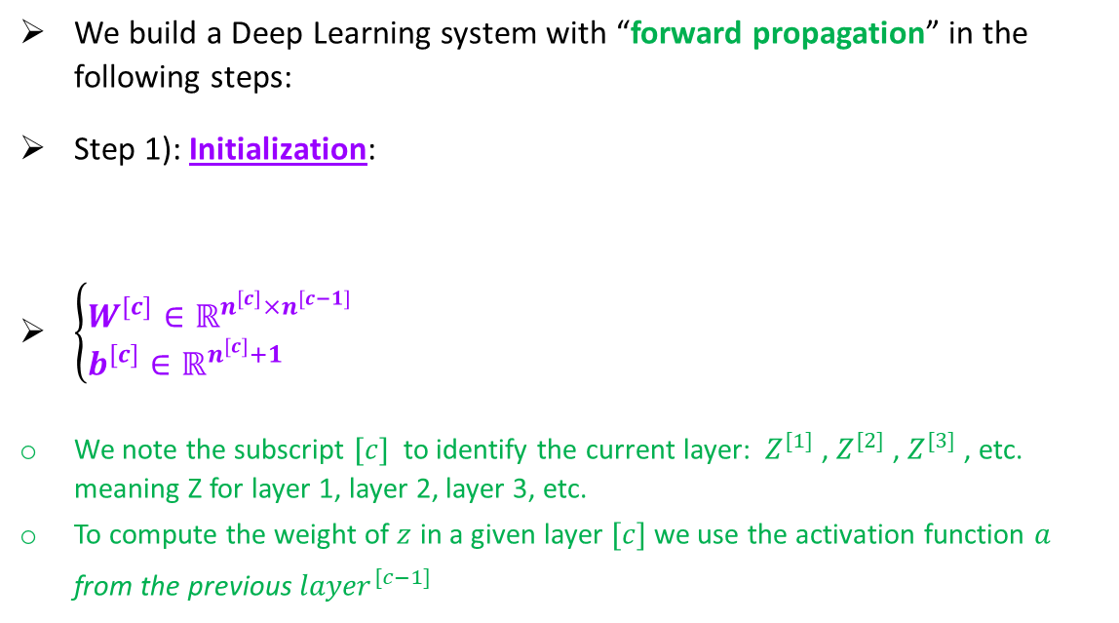
V. GENERALISATION: DEEP LEARNING ARCHITECTURE – FORWARD AND BACKWARD PROPAGATION
We build a Deep Learning system with “forward propagation” in the following steps:
Step 1): Initialization:
$\left\{\begin{aligned}&W^{[c]}∈ℝ^{n^{[c]}×n^{[c−1]}} \\ &b^{[c]}∈ℝ^{n^{[c]}+1}\end{aligned}\right.$
We note the subscript $[c]$ to identify the current layer: $Z^{[1]}$ , $Z^{[2]}$ , $Z^{[3]}$ , etc. meaning Z for layer 1, layer 2, layer 3, etc.
To compute the weight of $z$ in a given layer $[c]$ we use the activation function $a$ from the previous ${layer}^{[c−1]}$

Slide 43

Step 2): Forward Propagation
$\begin{aligned}&z^{[c]}=w^{[C]}⋅A^{[c−1]}+b^{[c]} \\ &A^{[c]}=\frac{1}{1+e^{−z^{[C]}}} \\ &\end{aligned}$
NB: For the first layer $x≃A^{[2]}$

Slide 44
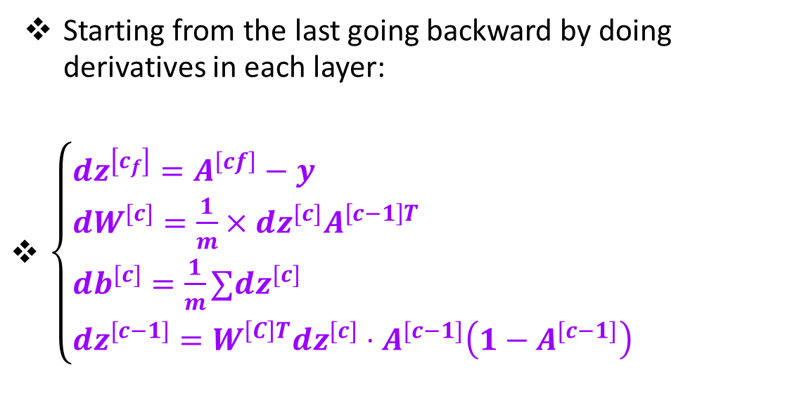
Step 3): Back Propagation:
Starting from the last going backward by doing derivatives in each layer:
$\left\{\begin{aligned}&dz^{\left[c_{f}\right]}=A^{\left[cf\right]}−y \\ &dW^{[c]}=\frac{1}{m}×{dz}^{[c]}A^{\left[c−1\right]T} \\ &db^{[c]}=\frac{1}{m}∑dz^{[c]} \\ &dz^{[c−1]}=W^{\left[C\right]T}dz^{[c]}⋅A^{[c−1]}\left(1−A^{[c−1]}\right)\end{aligned}\right.$

Slide 45
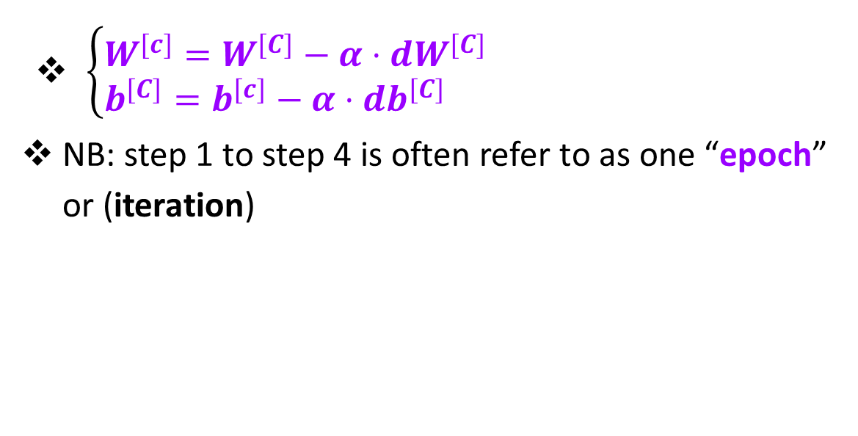
Step 4): Update Weights with Gradient Descent Algorithm
$\left\{\begin{aligned}&W^{[c]}=W^{[C]}−α⋅dW^{[C]} \\ &b^{[C]}=b^{[c]}−α⋅db^{[C]}\end{aligned}\right.$
NB: step 1 to step 4 is often refer to as one “epoch” or (iteration)

Slide 46
IMPLEMENTATION - Loss function
Loss functions quantify the agreement between the predicted output (or label) and the ground truth output. We use loss functions to determine the penalty for an incorrect classification of an input vector
Actual output for a given input comparing to correct output.
Objective I to minimize the loss by improving the model prediction
This lead to correctly choose the weights and the biases of each neuron in the network.
Gradient descent is an optimisation algorithm to iterate on the different weights toward the best weights for minimizing the loss.

Slide 47
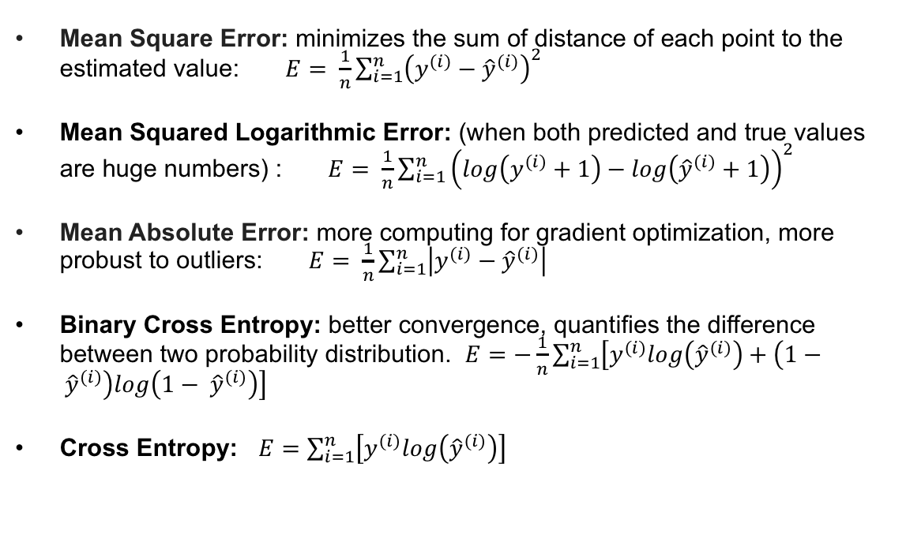
Loss function (energy function)
Mean Square Error: minimizes the sum of distance of each point to the estimated value: $E= \frac{1}{n}\sum_{i=1}^{n}{{\left(y^{(i)}−{\hat{y}}^{(i)}\right)}^{2}}$
Mean Squared Logarithmic Error: (when both predicted and true values are huge numbers) : $E= \frac{1}{n}\sum_{i=1}^{n}{{\left(log\left(y^{(i)}+1\right)−log\left({\hat{y}}^{(i)}+1\right)\right)}^{2}}$
Mean Absolute Error: more computing for gradient optimization, more probust to outliers: $E= \frac{1}{n}\sum_{i=1}^{n}{\left|y^{(i)}−{\hat{y}}^{(i)}\right|}$
Binary Cross Entropy: better convergence, quantifies the difference between two probability distribution. $E=−\frac{1}{n}\sum_{i=1}^{n}{\left[y^{(i)}log\left({\hat{y}}^{(i)}\right)+\left(1− {\hat{y}}^{(i)}\right)log\left(1− {\hat{y}}^{(i)}\right)\right]}$
Cross Entropy: $E=\sum_{i=1}^{n}{\left[y^{(i)}log\left({\hat{y}}^{(i)}\right)\right]}$

Slide 48
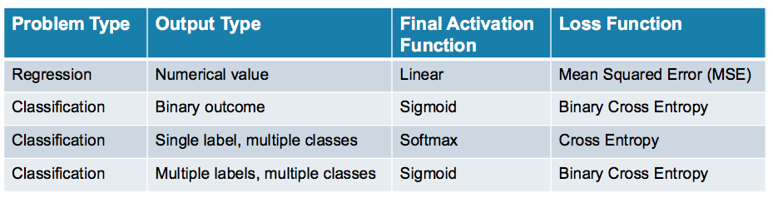
What loss function to use?
Categorical cross entropy: one-hot encoded targets [1 0 0 ],
Sparse categorical cross entropy: Integers targets[2 3 4]

Slide 49
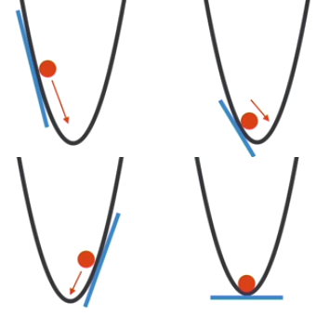
Optimizers
Gradient Descent-
Stochastic gradient descent
Mini Batch Gradient Descent
Optimizing the Gradient Descent-
Momentum
Nesterov accelerated gradient
Adagrad
RMSProp
Adam
https://hackernoon.com/demystifying-different-variants-of-gradient-descent-optimization-algorithm-19ae9ba2e9bc
Adam works well in practice and outperforms other Adaptive techniques.

Slide 50

IMPLEMENTATION: Training Deep Learning Model
The most basic method of training a deep learning neural network is trial and error.
If the network isn't behaving the way it should, change the weighting
of a random link by a random amount. If the accuracy of the network
declines, undo the change and make a different one.
A Deep Learning model is trained in 4 steps:
Step 1: getting inputs: numeric & non-numeric data
Step 2: Forward Propagation: feeding inputs through layers to get output
Step 3: Back-propagation: getting gradients in each layer
Step 4: updating the weight to minimize the error:
https://playground.tensorflow.org/
Sample labeled data
(batch)
Forward it through the network, get predictions
Back-propagate the errors
Update the network weights
$$W ←W−η\frac{∂E}{∂W}$$

Slide 51
IMPLEMENTATION: Terminologies
Weight (w): is coefficient that scale (amplify or minimize) the input signal to a given neuron in the network.
Bias (b): is scalar value added to the input to ensure that at least a few nodes per layer are activated regardless of signal strength
Activation function (f): The function that govern the artificial neuron’s behavior.
Learning
Adjust neural network weights to map inputs to outputs and minimize the error.
Error
The error value is the amount by which the value output by the network differs from the target value.
Epoch
Cycle of presentation of the entire training set to the neural network.
Cross validation
An often-proposed solution for these problems is to divide, the training set into
training set really used to train ,
verification set to test the progress

Slide 52



Keras
If you want to learn theano:
http://speech.ee.ntu.edu.tw/~tlkagk/courses/MLDS_2015_2/Lecture/Theano%20DNN.ecm.mp4/index.html
http://speech.ee.ntu.edu.tw/~tlkagk/courses/MLDS_2015_2/Lecture/RNN%20training%20(v6).ecm.mp4/index.html
Very flexible
or
Need some effort to learn
Easy to learn and use
Interface of TensorFlow or Theano
(still have some flexibility)
keras
You can modify it if you can write TensorFlow or Theano
Notes:
台大上課
太過 ＯＰ
Toolkit

Slide 53
IMPLEMENTATION: Tensor Flow
Originally developed by Google Brain Team to conduct machine learning and deep neural networks research
Open source software library for numerical computation using data flow graphs
Applicable in a wide variety of other machine learning domains
Allow users to build various models from scratch.
Flexibility; from Raspberry Pi, Android, Windows, iOS, Linux to server farms
Visualization (via TensorBoard)

Slide 54



























Tensor Flow
More: https://outsourceit.today/companies-using-TensorFlow/

Slide 55
IMPLEMENTATION: Machine Learning with TensorFlow
General model:
y=f(x)
Regression
Simple linear regression
Multi regression
Regularized regression
Lasso regularization
Ridge regularization
ElasticNet regularization
Classification
Classification using logistic regression
Binary classification
Multiclass classification

Slide 56
Keras : Deep Neural Network library
Keras is a high-level neural networks API, written in Python and capable of running on top of TensorFlow, CNTK, or Theano. It was developed with a focus on enabling fast experimentation. Being able to go from idea to result with the least possible delay is key to doing good research.
Use Keras if you need a deep learning library that:
Allows for easy and fast prototyping (through user friendliness, modularity, and extensibility).
Supports both convolutional networks and recurrent networks, as well as combinations of the two.
Runs seamlessly on CPU and GPU.
Read the documentation at Keras.io.

Slide 57
Keras workflow
Prepare input data (Image, video, text, column data, ..)
Define the neural network architecture (sequential/functional)
Select the optimizer
Select the loss function
Select the appropriate evaluation metric for the given problem
Train and evaluate

Slide 58
Keras Model type
Sequential:
models are linear stack of layers
Treat each layer as object that feed into the next.
Graph
Optimized over all outputs
Graph model allows for two or more independent networks to diverge or merge
Allows for multiple separate inputs/outputs
Different merging layers

Slide 59
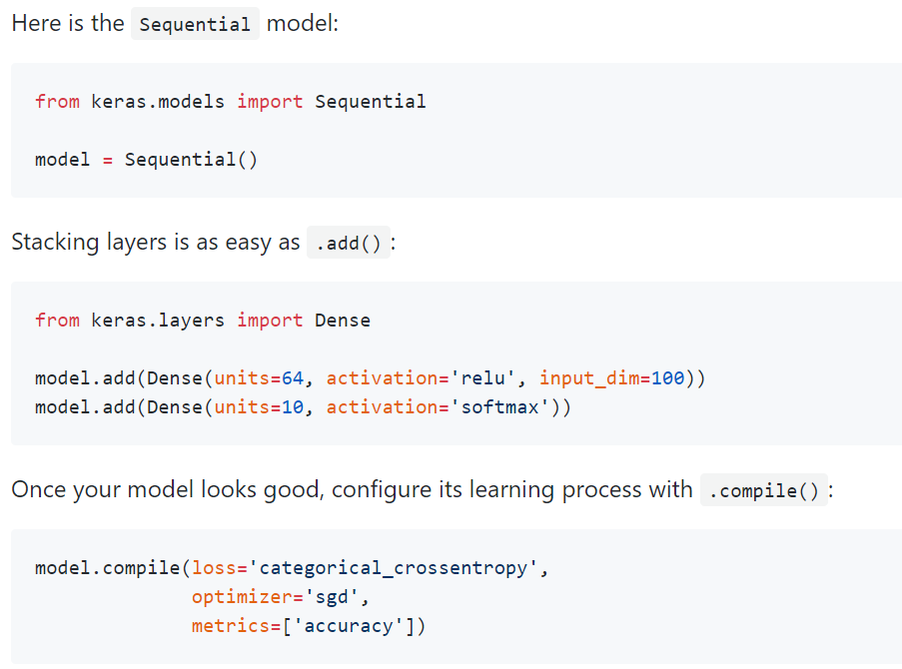
Sequential class

Slide 60
Keras Hyper parameters
Type of activation function
Learning rate
How many neurons in each layer
How many hidden layers do we need?
How many training sample do I need?
What the batch size should be?

Slide 61
Keras Hyper parameters
Number of layers:
0 hidden layer: Only capable of representing linear separable functions or decisions.
1 hidden layer: Can approximate any function that contains a continuous mapping from one finite space to another.
2 hidden layer: Can represent an arbitrary decision boundary to arbitrary accuracy with rational activation functions and can approximate any smooth mapping to any accuracy.
>2 hidden layer: Additional layers can learn complex representations (sort of automatic feature engineering) for layers.

Slide 62
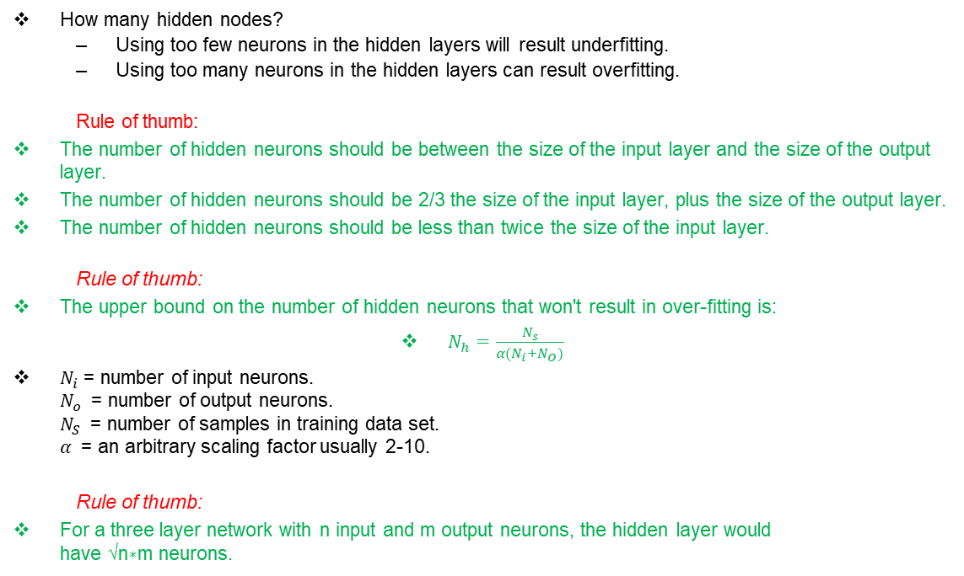
Keras Hyper parameters
How many hidden nodes?
Using too few neurons in the hidden layers will result underfitting.
Using too many neurons in the hidden layers can result overfitting.
Rule of thumb:
The number of hidden neurons should be between the size of the input layer and the size of the output layer.
The number of hidden neurons should be 2/3 the size of the input layer, plus the size of the output layer.
The number of hidden neurons should be less than twice the size of the input layer.
Rule of thumb:
The upper bound on the number of hidden neurons that won't result in over-fitting is:
$N_{h}=\frac{N_{s}}{α(N_{i}+N_{O})}$
$N_{i}$ = number of input neurons. $N_{o}$ = number of output neurons. $N_{S}$ = number of samples in training data set. $α$ = an arbitrary scaling factor usually 2-10.
Rule of thumb:
For a three layer network with n input and m output neurons, the hidden layer would have √n∗m neurons.

Slide 63
Keras Hyper parameters
Optimal batch size:
A smaller mini-batch size (not too small) usually leads not only to a smaller number of iterations of a training algorithm, than a large batch size, but also to a higher accuracy overall,
Too small mini-batch might get too slow because of significantly lower computational speed, because of not exploiting vectorization to the full extent. In this case the gradient of that sample may take you completely the wrong direction.
Rule of thumb:
usually 32--512 data points,

Slide 64
END
END

